Slide 2
Binghamton University EngiNet™ State University of New York

Slide 3
Thomas J. Watson School of Engineering and Applied Science

Slide 4
WARNING All rights reserved. No part of the course materials used in the instruction of this course may be reproduced in any form or by any electronic or mechanical means, including the use of information storage and retrieval systems, without written approval from the copyright owner. ©2017 International Business Machines and Binghamton University

Slide 5
CS480Z/CS580Z (Fall, 2017) (Tuesday’s and Thursday’s 11:40 to 1:05) Introduction to the Mainframe: z/VM Basics Lecture 9 September 26, 2017
Faculty : Emily K Hugenbruch, , Merwyn Jones
IBM z/VM Lab Development team
( http://www.vm.ibm.com/ )

Slide 6
Advanced XEDIT
Emily K Hugenbruch
Charts by Bruce Kavanagh z/VM Development Endicott, NY

Slide 7
Trademarks
The following are trademarks of the International Business Machines Corporation in the United States and/or other countries.
CICS*
DB2*
DB2 Connect
DB2 Universal Database
DFSMS/MVS*
DFSMS/VM*
e-business logo*
Enterprise Storage Server
ESCON
FICON
GDDM
HiperSockets
IBM*
IBM logo
Language Environment*
MQSeries*
Multiprise*
MVS
NetRexx
OpenEdition*
OpenExtensions
OS/390*
Parallel Sysplex*
PR/SM
QMF
RACF*
RAMAC*
RISC
S/370
S/370
S/390*
S/390 Parallel Enterprise Server
Virtual Image Facility
VisualAge*
VisualGen*
VM/ESA*
VTAM*
VSE/ESA
WebSphere
z/Architecture
z/OS
zSeries
z/VM*
* Registered trademarks of the IBM Corporation
The following are trademarks or registered trademarks of other companies.
Lotus, Notes, and Domino are trademarks or registered trademarks of Lotus Development Corporation.
Tivoli is a trademark of Tivoli Systems Inc.
Java and all Java-related trademarks and logos are trademarks of Sun Microsystems, Inc., in the United States and other countries
UNIX is a registered trademark of The Open Group in the United States and other countries.
Microsoft, Windows and Windows NT are registered trademarks of Microsoft Corporation.
Notes:
Performance is in Internal Throughput Rate (ITR) ratio based on measurements and projections using standard IBM benchmarks in a controlled environment. The actual throughput that any
user will experience will vary depending upon considerations such as the amount of multiprogramming in the user's job stream, the I/O configuration, the storage configuration, and the
workload processed. Therefore, no assurance can be given that an individual user will achieve throughput improvements equivalent to the performance ratios stated here.
IBM hardware products are manufactured from new parts, or new and serviceable used parts. Regardless, our warranty terms apply.
All customer examples cited or described in this presentation are presented as illustrations of the manner in which some customers have used IBM products and the results they may have
achieved. Actual environmental costs and performance characteristics will vary depending on individual customer configurations and conditions.
This publication was produced in the United States. IBM may not offer the products, services or features discussed in this document in other countries, and the information may be subject
to change without notice. Consult your local IBM business contact for information on the product or services available in your area.
IBM considers a product “Year 2000 ready” if the product, when used in accordance with its associated documentation, is capable of correctly processing, providing and/or receiving date
data within and between the 20th and 21st centuries, provided that all products (for example, hardware, software and firmware) used with the product properly exchange accurate date data
with it. Any statements concerning the Year 2000 readiness of any IBM products contained in this presentation are Year 2000 Readiness Disclosures, subject to the Year 2000 Information
and Readiness Disclosure Act of 1998.
All statements regarding IBM's future direction and intent are subject to change or withdrawal without notice, and represent goals and objectives only.
Information about non-IBM products is obtained from the manufacturers of those products or their published announcements. IBM has not tested those products and cannot confirm the
performance, compatibility, or any other claims related to non-IBM products. Questions on the capabilities of non-IBM products should be addressed to the suppliers of those products.

Slide 8
Disclaimer
The information contained in this document is not intended to be an assertion of future action by IBM. The use of this information or the implementation of any of these techniques is a customer responsibility and depends on the customer's ability to evaluate and integrate them into the operational environment. While each item may have been reviewed by IBM for accuracy in a specific situation, there is no guarantee that the same or similar results will be obtained elsewhere. Customers attempting to adopt these techniques to their own environment do so at their own risk.
In this presentation, any references made to an IBM licensed program are not intended to state or imply that only IBM's licensed program may be used; any functionally equivalent program may be used instead.
Any performance data contained in this presentation was determined in a controlled environment and, therefore, the results which may be obtained in other operating environments may vary significantly. Users of this presentation should verify the applicable data for their specific environment.
It is possible that this material may contain reference to, or information about, IBM products (machines and programs), programming, or services that are not announced in your country. Such references or information must not be construed to mean that IBM intends to announce such IBM products, programming or services in your country.
Any feedback that you give IBM regarding this presentation will be treated as non-confidential information. IBM reserves the right to use this information in any form.

Slide 9
Agenda
Review
PROFILE XEDIT
Comparing XEDIT with BROWSE
Attributes of a File
Full-Screen Text Processing
Using Targets
Other Useful Xedit Macros
Editing Multiple Files

Slide 10
References
VM Library
z/VM: XEDIT User’s Guide
z/VM: XEDIT Commands and Macros Reference
z/VM: CMS Application Development Guide (Chapter 8. Updating Your Source Program)
HELP Facility
HELP XEDIT
HELP XEDIT MENU
In an XEDIT session, type HELP
Examples on the BINGTZ1 VM system are on my VMSYSU:BAK.EXAMPLES SFS directory

Slide 11

Review
Command: Xedit TEST FILE A
Each line is a record
Screen Layout:
RECFM
|
TEST FILE A1 F 80 Trunc=80 Size=9 Line=0 Col=1 Alt=0
|
LRECL
===== * * * Top of File * * *
|...+....1....+....2....+....3....+....4....+....5....+....6....+....7...
===== one
===== two
===== three
===== four
===== five
===== six
===== seven
===== eight
===== nine
====>
X E D I T 1 File
Current Line
Scale
Data Area
Prefix Area
Command Line

Slide 12
Review
The scale can have some special characters (<,>,|,T)
Some special characters overlay others if on same column
SET Trunc 41
SET Zone 1 32
CLocate :8
<...+..|.1....+....2....+....3.>..+....4T...+....5....+....6....+....7...
column pointer
truncation column
left zone right zone
Notes:
Zone sets the zone in which searches will be performed
Trunc is the last column in which you can enter data
Clocate will move the pointer to that column or will search on a string

Slide 13
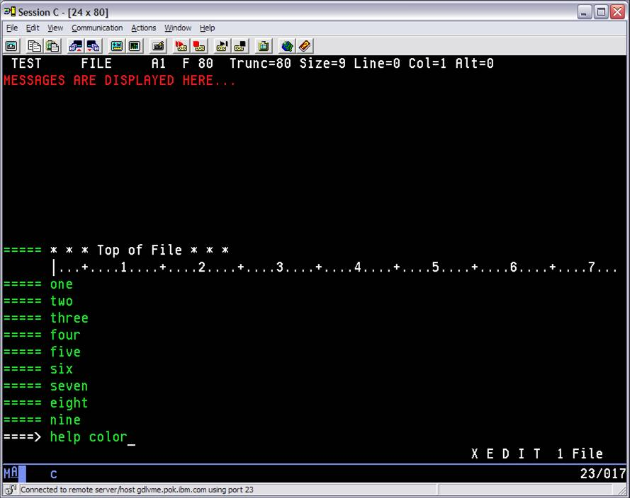

Slide 14
PROFILE XEDIT
PROFILE XEDIT, an XEDIT MACRO, runs every time when XEDIT is invoked unless option “(NOPROF” or “(PROF macroname” is issued
Note: XEDIT is very tailorable !
/* SAMPLE PROFILE XEDIT, in REXX */
'SET NUMBER ON'
'SET PREFIX NULL'
'SET CURLINE ON 4'
'SET SCALE OFF'
'SET CASE MIXED IGNORE'
'SET SYNONYM QPF QUERY PF' /* Used to change name of a subcommand */
'SET COLOR MSGLINE RED HIGH'
'SET COLOR CMDLINE BLUE HIGH'
'SET COLOR CURLINE PINK HIGH REVVIDEO'
'SET COLOR IDLINE YELLOW HIGH'
'SET COLOR ARROW BLUE NOHIGH'
'SET COLOR FILEAREA TURQUOISE'
'SET COLOR PREFIX YELLOW'

Slide 15
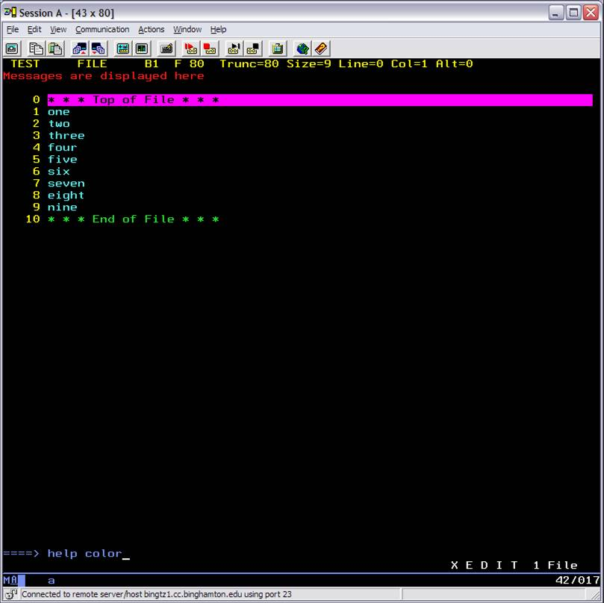

Slide 16
PROFILE XEDIT
Need to know if PROFILE XEDIT is in REXX or EXEC2.
If first line starts with ‘/*’ then it’s in REXX, otherwise it’s EXEC or EXEC2
For more versatility, it’s best to convert PROFILE XEDIT to REXX
SET CASE Mixed Ignore …do not translate uppercase or lowercase, and in XEDIT searches, either case match
SET AUtosave 3 …creates a numbered file, rnnnnn AUTOSAVE after every 3 changes, to protect against lost changes or if want to undo
(Ex. 100001 AUTOSAVE)
SET NUMber ON …display line numbers in prefix area
SET PREfix Nulls …displays nulls in prefix area (enabling the insert key)
SET NULLS ON …trailing blanks replaced with nulls (enabling the insert key)
SET FULLread ON …allows null characters in the middle of screen lines without worrying about being crushed to the left
SET WRap ON …allows wrap around file if EOF is reached
SET STAY ON ...stay at location of last find vs bottom of file
SET SERial OFF …serialization area not to be touched (used for update mode)

Slide 17
Comparing XEDIT with BROWSE Both can be used to view and search files, however:
XEDIT
Edits or changes files
Slower on large files
Uses any screen size
Many subcommands
File may be too large (not enough storage)
BROWSE
Only scans a file
Faster on large files
Forces certain sizes
Limited subcommands
File never too large to BROWSE

Slide 18
Attributes of a File
Includes:
LRecl logical record length
RECFm record format, variable or fixed
TRunc truncation column
Verify
Defines the columns that are to be displayed
Controls whether lines changed are to be displayed in the message area
All changed by the SET subcommand
View all attributes by STATUS macro or QUERY one at a time (e.g. Query LRecl)

Slide 19
XEDIT Attributes File Type Defaults
FILETYPE SERIAL TRUNC LRECL RECFM VERIFY CASE
$EXEC ON 72 80 F 72 M
$XEDIT ON 72 80 F 72 M
ASSEMBLE ON 71 80 F 72 U
BASIC OFF 156 156 V T M
EXEC OFF 130 130 V T U
FORTRAN ON 72 80 F T U
JOB OFF 80 80 F T U
LISTING OFF 121 121 V T U
MACLIB OFF 71 80 F 72 U
MACRO ON 71 80 F 72 U
NAMES OFF 255 255 V T M
NETLOG OFF 255 255 V T M
NOTE OFF 132 132 V T M
REXX OFF 255 255 V T U
SCRIPT OFF 132 132 V T M
TEXT OFF 80 80 F 72 M
UPDATE ON 71 80 F 72 U
XEDIT OFF 255 255 V T U
Others OFF 80 80 F ** U

Slide 20
XEDIT Attributes File Type Defaults
FILE TYPE TAB SETTINGS
$EXEC 1 4 7 10 13 16 19 22 25 31 37 43 49 55 79 80
$REXX 1 4 7 10 13 16 19 22 25 31 37 43 49 55 79 80
$XEDIT 1 4 7 10 13 16 19 22 25 31 37 43 49 55 79 80
ASSEMBLE 1 10 16 30 35 40 45 50 55 60 65 70
BASIC 1 7 10 15 20 25 30 35 40 45 50 55 60 65 70 75 80 85 90 95 100 105 110 115 120
CNTRL 1 5 8 17 27 31
COPY 1 10 16 30 35 40 45 50 55 60 65 70
EXEC 1 4 7 10 13 16 19 22 25 31 37 43 49 55 79 80
LISTING 1 5 10 15 20 25 30 35 40 45 50 55 60 65 70 75 80 85 90 95 100 105 110 115 120
MACRO 1 10 16 30 35 40 45 50 55 60 65 70
MEMO 1 10 16 30 35 40 45 50 55 60 65 70
NAMES 1 5 10 15 20 25 30 35 40 45 50 55 60 65 70 75 80 85 90 95 100 105 110 115 120
NETLOG 1 5 10 15 20 25 30 35 40 45 50 55 60 65 70 75 80 85 90 95 100 105 110 115 120
NOTE 1 5 10 15 20 25 30 35 40 45 50 55 60 65 70 75 80 85 90 95 100 105 110 115 120
NOTEBOOK 1 5 10 15 20 25 30 35 40 45 50 55 60 65 70 75 80 85 90 95 100 105 110 115 120
PASCAL 1 5 10 15 20 25 30 35 40 45 50 55 60 65 70 75
PLI 1 4 7 10 13 16 19 22 25 31 37 43 49 55 79 80
REXX 1 4 7 10 13 16 19 22 25 31 37 43 49 55 79 80
SCRIPT 1 5 10 15 20 25 30 35 40 45 50 55 60 65 70 75 80 85 90 95 100 105 110 115 120
TEXT 1 5 10 15 20 25 30 35 40 45 50 55 60 65 70 75 80
UPDATE 1 10 16 30 35 40 45 50 55 60 65 70
XEDIT 1 4 7 10 13 16 19 22 25 31 37 43 49 55 79 80
Others 1 5 10 15 20 25 30 35 40 45 50 55 60 65 70 75 80 85 90 95 100 105 110 115 120

Slide 21
Attributes of a File
To change the width of a file:
XEDIT Fn Ft Fm (Width num
For Fixed Format files, may need to issue:
SET LRecl num
SET Trunc num
Also, CMS COPYFILE can be used to change the width and a few other attributes

Slide 22
Full-Screen Text Processing
Default XEDIT PF keys 1-6
PF1 BEFORE HELP MENU
BEFORE specifies executing PF before contents of command line
PF2 BEFORE SOS LINEADD
Screen Operation Simulation set of functions for macros or PF keys
LINEADD adds a blank line after the line the cursor points to.
PF3 BEFORE QUIT
Quits out of a file it there were no changes made
PF4 BEFORE TABKEY
Cursor is moved to next tab column, defined by SET TABS
PF5 BEFORE SCHANGE 6
Selective Change macro to locate a string and change, if choose to
Works with a PF key, default PF6, that causes CHANGE to execute
PF6 ONLY ?
ONLY specifies executing only the PF, ignoring the command line
This displays the last command executed (like RETRIEVE)

Slide 23
Full-Screen Text Processing
Default XEDIT PF keys 7-12
PF7 BEFORE BACKWARD
Page backward, or wrap to bottom of file if at top of file
PF8 BEFORE FORWARD
Page forward, or wrap to top of file if at bottom of file
PF9 ONLY =
Used to re-execute the last command entered
PF10 BEFORE RGTLEFT
Used to view columns of data not currently visible on screen
PF11 BEFORE SPLTJOIN
With cursor in position, used to split a line if data comes after the cursor, or join two lines (the following line) if no data after cursor
PF12 BEFORE CURSOR HOME
Moves cursor form command line to the screen or from the screen to the command line

Slide 24
Full-Screen Text Processing
Some additional prefix subcommands:
Use E prefix subcommand to extend logical line by one more screen line (If prefix E is invalid for the line, then need to extend the endcol of SET VERIFY)
Use SI prefix subcommand to continuously add a new line and position the cursor at the same column as previous line
RESET cancels all prefix subcommands

Slide 25
Full-Screen Text Processing Prefix subcommand (HELP PREFIX)
. = Set symbolic name
< = Shift left
/ = Set current line
> = Shift right
" = Duplicate
A = Add
C = Copy
D = Delete
E = Extend
F = Following
I = Insert
M = Move
P = Preceding
S = Show
SCALE = Display scale
SI = Structured input
TABL = Set tab line
X = Exclude

Slide 26
Full-Screen Text Processing
Putting or getting lines or files
PUT target/* Fn Ft Fm
Puts one or more lines into file Fn Ft Fm
If no file specified, XEDIT puts in a temporary file, available to GET subcommand, but only while XEDIT session is still open (similar to clipboard)
PUTD target/* Fn Ft Fm
Same as PUT but also deletes original lines from the editing file
GET Fn Ft Fm firstrec numrec
Inserts all or part of a specified file after current line
If no file specified, XEDIT gets temporary file from PUT or PUTD

Slide 27
Full-Screen Text Processing
Another useful trick is to use cut or copy and paste
Use the Esc key to undo any changes made since the last Enter key was hit
Recovering deleted lines from an XEDIT session
RECOVER num
Where num is the number of lines to recover or * to recover all deleted lines
Default is to recover just the last line removed
Lines removed by a DELETE, a MERGE, a PUTD, or a D prefix subcommand can be restored

Slide 28
Using Targets
A way to identify a line to the editor
Can express a target in the following ways:
An absolute line number (:6)
A relative displacement from current line (6 or -6)
A line name
To set current line, issue SET POINT .symbol
Or put .symbol on prefix line to assign (limit to 4 char)
Then can reference that line by the name .symbol
A simple or complex string expression (/string/)
+ or -, NOT symbol (¬), OR symbol (|), AND symbol(&)
/this/ & /that/ | /those/ & ¬/these/
A target by itself implies the LOCATE command

Slide 29
Using Targets
ALL target …to display specified lines
SET SHADOW ON …displays a shadow line telling the number of lines omitted (default)
SET SHADOW OFF …removes shadow lines
ALter char1 char2 target
Used to change a single character, especially hex values, that may not be available on the keyboard
Change /string1/string2/ target
Change /BS/PhD/*
To change hex:
SET HEX ON
Change /X’nn’/X’nn’/ target
COUnt /string/ target
Used to count characters or strings
Zone col1 col2
Used to set columns or zones for target searches

Slide 30
Using Targets
HEXType target
Used to display a specified number of lines in both hexadecimal and EBCDIC
Verify Hex 1 20
Used to display the data in hexadecimal notation from column 1 to 20
SORT target A/D col1 col2
Used to arrange a specified number of lines in Ascending or Descending order to specified sort columns
Using SET ARBchar
SET ARBchar ON/OFF char
Initial char setting is the dollar sign ($)
Defines an arbitrary character for use in a target definition. A arbitrary character between character strings in a target means to ignore all intervening characters
See HELP SET ARBCHAR …for many examples
Example to delete all characters between columns 1 and 10:
ZONE 1 10
SET ARBCHAR ON $
Change /$// *
UPPercas target and LOWercas target
Used to upper or lower case all characters in a specified number of lines

Slide 31
Using Targets
XEDIT subcommands using the column pointer
CDelete column_target
Delete one or more characters from current line starting at col pointer
CFirst
Move the column pointer to the beginning of the zone (SET ZONE)
CInsert text
Insert text in current line starting at the column pointer
CLAst
Move the column pointer to the end of the zone (SET ZONE)
CLocate column_target
Searches for target and moves column pointer if target found
CLocate :5 …moves the column pointer to column 5
COVerlay text
Overlays text starting at column pointer
CReplace text
Replaces one or more characters, one-for-one, in current line with text starting at the column pointer

Slide 32
Other Useful Xedit Macros
Available from:
Also found on VMSYSU:BAK.DOWNLOADS
These download packages may not be supported
Companies may not want to use anything that isn’t base VM
XCOL Package
COL XEDIT
COL allows you to edit columns in the same way that you edit lines when using Xedit's prefix commands.
DELMACS Package
Set of macros to selectively delete data
DELDUPES XEDIT …deletes duplicate lines
Can use SET ZONE to limit columns for duplicates

Slide 33
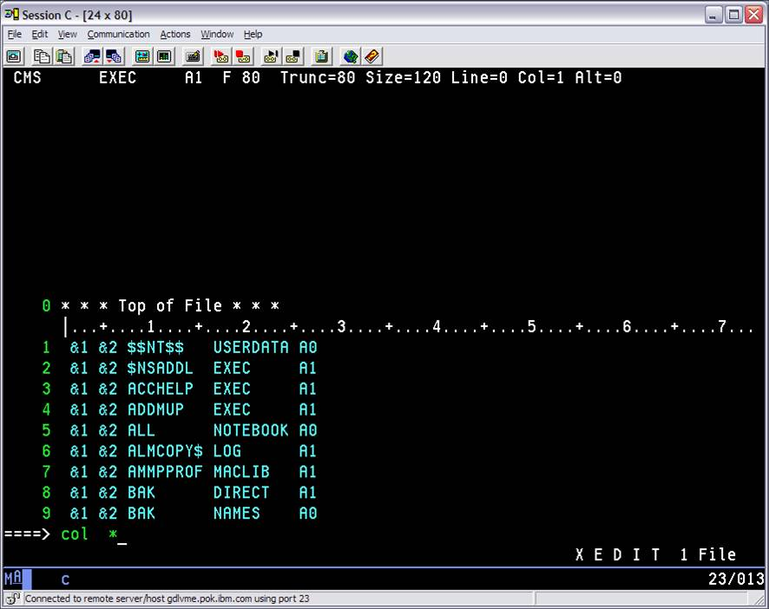
Using the COL macro

Slide 34
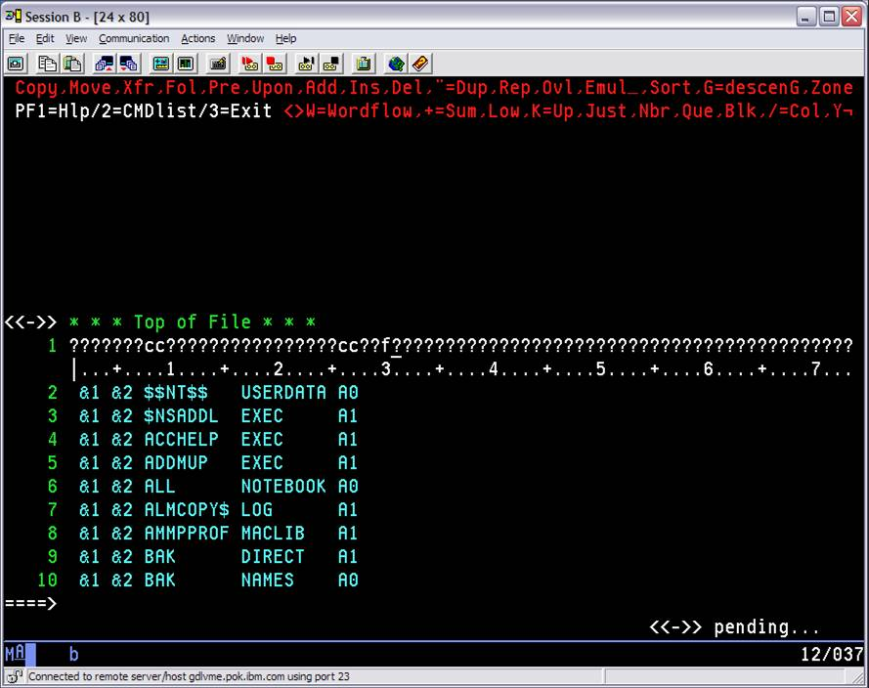

Slide 35
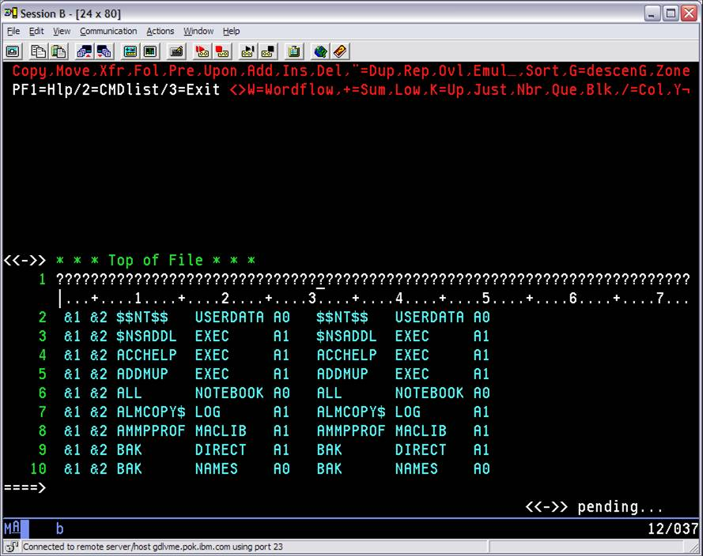

Slide 36
Editing Multiple Files
By entering the XEDIT subcommand during an editing session, you can bring in more than one file at a time
Multiple files are kept in a “ring”
Files remain in the ring until QUIT or FILE each file
Used the CANCEL macro to terminate all XEDIT sessions for all files
Entering XEDIT without operands brings the next file in the ring to the screen
Entering XEDIT with the file ID, brings that file to screen regardless of its relative position in ring
May start multiple rings using ‘CMS XEDIT’ command (different from XEDIT subcommand)

Slide 37
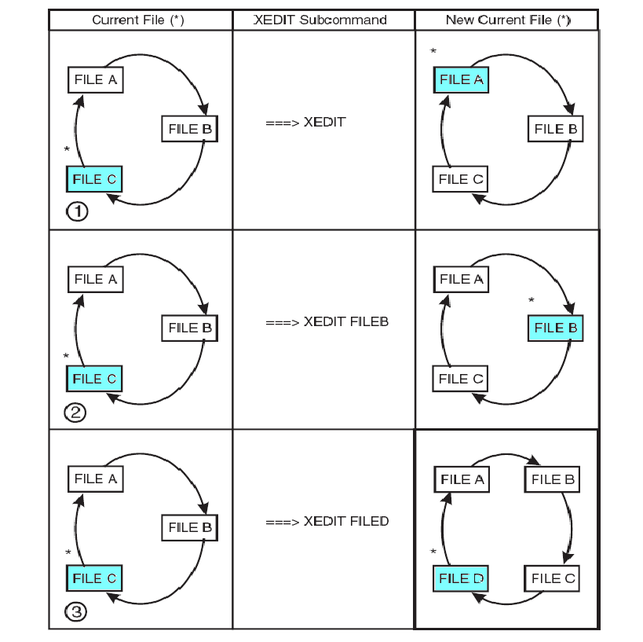

Slide 38
Editing Multiple Files
Use the SET SCREEN subcommand to split the screen into logical screens to view multiple files, or multiple views of same file
If multiple files in the ring, increasing the logical screens will have files from the ring fill the additional screens
Editing another file from one of the multiple logical screens will bring that file into the ring.
Can view multiple files vertically or horizontally, or define own cross-section

Slide 39
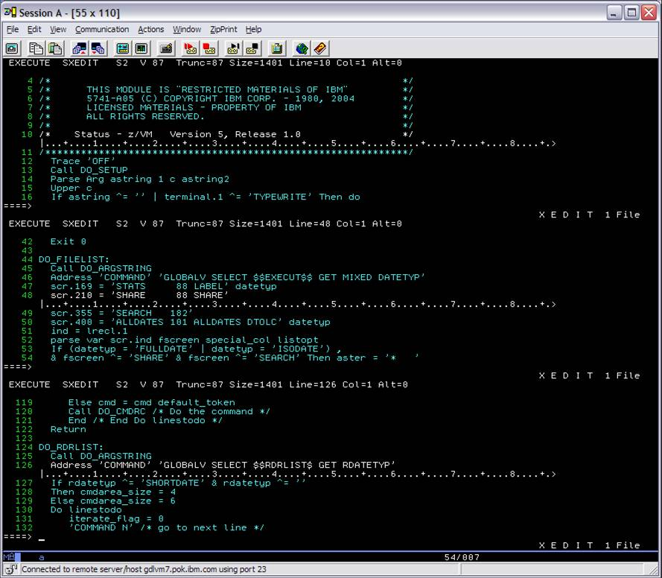

Slide 40
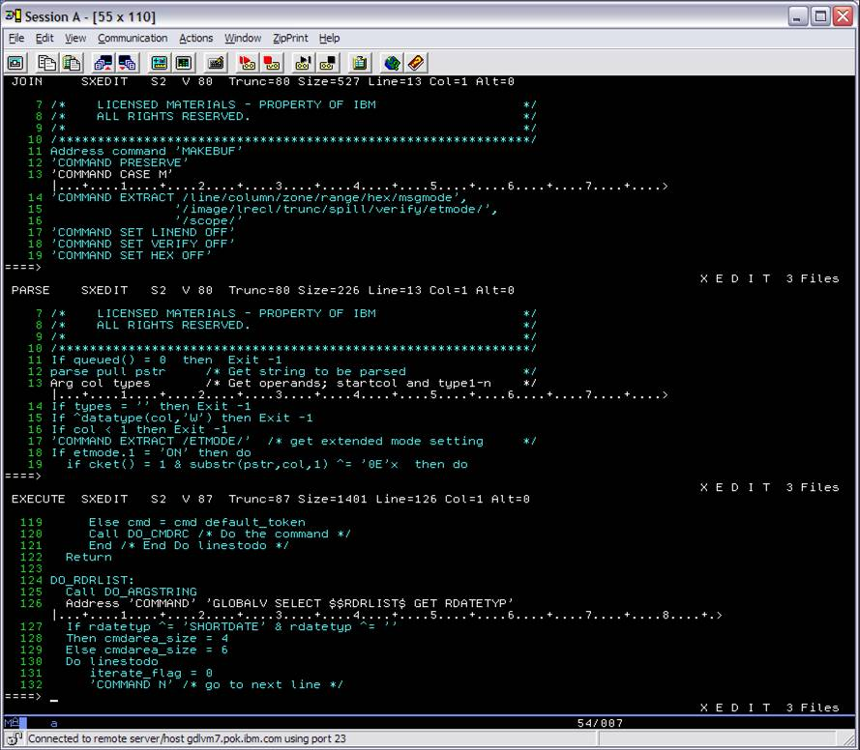

Slide 41
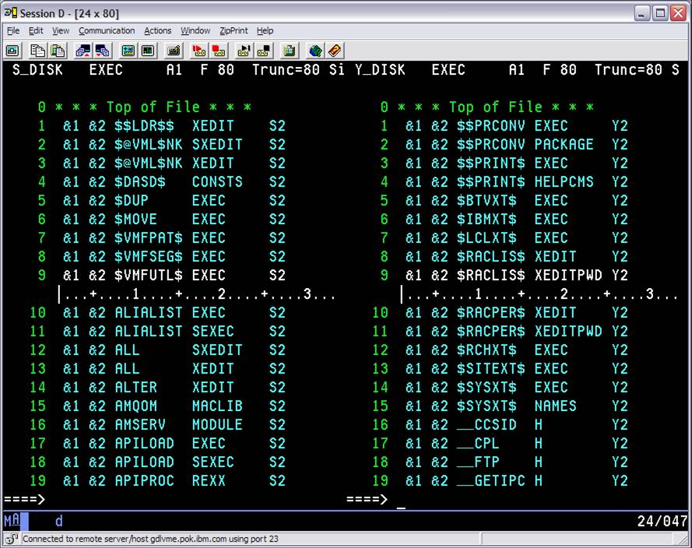

Slide 42
XEDIT Assignment 1
Copy the file, SAMPLE LIST, from VMSYSU:BAK.DOWNLOADS onto your ‘A’ disk. To copy the file:
Do DIRLIST VMSYSU:BAK.ASSIGNMENT1
In the filelist next to SAMPLE LIST do COPY / = = A

Slide 43
XEDIT Assignment 1
Copy the file, SAMPLE LIST, from VMSYSU:BAK.DOWNLOADS onto your ‘A’ disk. Then manipulate the file to:
Remove all lines that are not EXEC, REXX, or XEDIT file types (do not include SEXEC, SREXX, or SXEDIT)
Remove all columns except filename, filetype and filemode, so that filenames start in column 2 and a blank is in column 1
Sort the EXEC lines in ascending order and move to the top of the file
Sort the XEDIT lines in ascending order following the EXEC lines
Sort the REXX lines in descending order following the XEDIT lines, and change these REXX lines to lowercase
At the top of each group of files (EXEC, XEDIT and REXX), insert a line that says “***START OF GROUP OF FILES***”

Slide 44
XEDIT Assignment 1
Count the number of capital ‘E’s in the filenames (not filetypes)
Find which line contains the string “REXXCHPF”
Insert a line at the top which says …
your name, the number of capital 'D’s and the line number from step 9
Use HELP to find out how many different colours you can use in XEDIT
Insert the number of different colours in XEDIT as the second line
rename filename SAMPLE to your Userid
Send the file, Userid LIST, to MERWYN

Slide 45
References
VM Library
z/VM: XEDIT User’s Guide
z/VM: XEDIT Commands and Macros Reference
z/VM: CMS Application Development Guide (Chapter 8. Updating Your Source Program)
HELP Facility
HELP XEDIT
HELP XEDIT MENU
In an XEDIT session, type HELP
Examples on the BINGTZ1 VM system are on my VMSYSU:BAK.EXAMPLES SFS directory

Slide 46
Backup

Slide 47
Writing XEDIT Macros
An XEDIT macro is a REXX file invoked from the XEDIT environment, executed like XEDIT subcommands on the command line or in the prefix area, and must have a file type of XEDIT
A macro can contain:
XEDIT subcommands
REXX instructions
CMS or CP commands
PIPE commands
Prefix macro names cannot contain numbers
Command line names may contain numbers but then may need to be preceded by MACRO subcommand to execute

Slide 48
Writing XEDIT Macros
Communicating between XEDIT and REXX
READ
Editor displays “Macro-read” in status area of screen and waits for data or key to be pressed (e.g. HELP command)
Data is placed in the console stack
The REXX PULL takes data out of console stack
EXTract /operand/
Returns info about internal XEDIT variables or about file data and puts in a stem variable name, operand.n
HELP EXTRACT shows list of operands to extract
EXTract /Zone/LIne/EOF/ALT/SIZe
Returns info in multiple stem variable names
EXTract /CURLine/ …used to extract the current line
CURLINE.2 …contains the actual line number
CURLINE.3 …contains the contents of the current line

Slide 49
Writing XEDIT Macros
MSG, EMSG, and CMSG
MSG displays message on message line
EMSG displays on message line and sounds the alarm
CMSG displays message on the command line and can redisplay input the user has entered incorrectly to reenter it
Passing information to a macro
REXX ARG statement in macro used to retrieve argument strings passed to the macro
An argument string is automatically passed to a macro when
Invoking a prefix macro
Sample argument passed: PREFIX SET Line#
Example to view: PREFIXX SXEDIT S2
Macro is used in the PROFILE option to XEDIT
XEDIT Fn Ft Fm (PROFile macroname
The PROFILE XEDIT is replaced by macroname
Argument passed: Fn Ft Fm ( PROFILE macroname

Slide 50
Writing XEDIT Macros
Saving and restoring editing variables
PRESERVE saves the settings of various XEDIT variables
RESTORE restores the settings of various XEDIT variables to values set by PRESERVE
Avoiding name conflicts
COMMAND subcommand
Causes XEDIT to execute subcommand without first checking for identical synonym or macro
MACRO macro
Causes the operand to be executed as a macro without first checking for identical synonym or subcommand
SET MACRO ON …tells XEDIT to use a macro before a subcommand
SET MACRO OFF …reverses the order
CMS …(CMS commands)
CP …(CP commands)

Slide 51
Writing XEDIT Macros
The SET MSGMODE subcommand controls whether messages are displayed
SET MSGMODE ON …messages displayed
SHORT or LONG option determines if informational or warning messages are displayed
SET MSGMODE OFF …no messages displayed
To view some XEDIT macros: FILELIST * *XEDIT S
Some XEDIT macros are compiled, so look at SXEDIT
Following XEDIT macro, CHGDATES XEDIT, changes the dates in a project schedule, file SCHEDULE SCRIPT
XEDIT SCHEDULE SCRIPT
Type CHGDATES 35
This will move the dates out 5 weeks

Slide 52
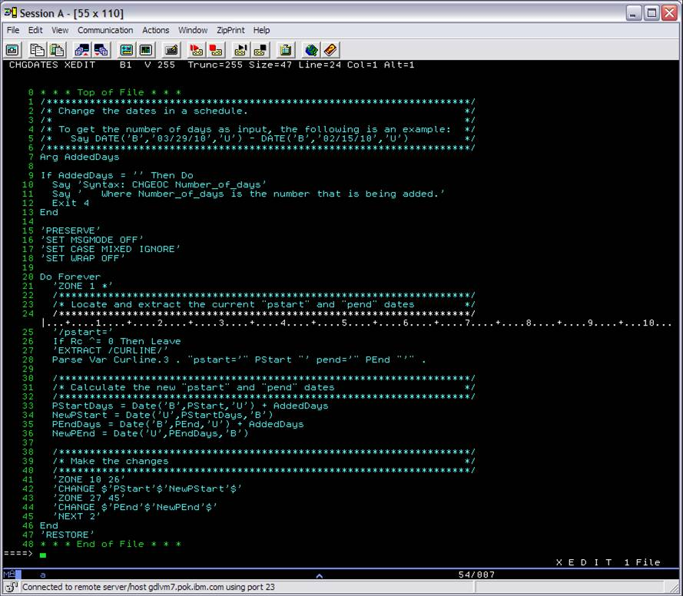

Slide 53
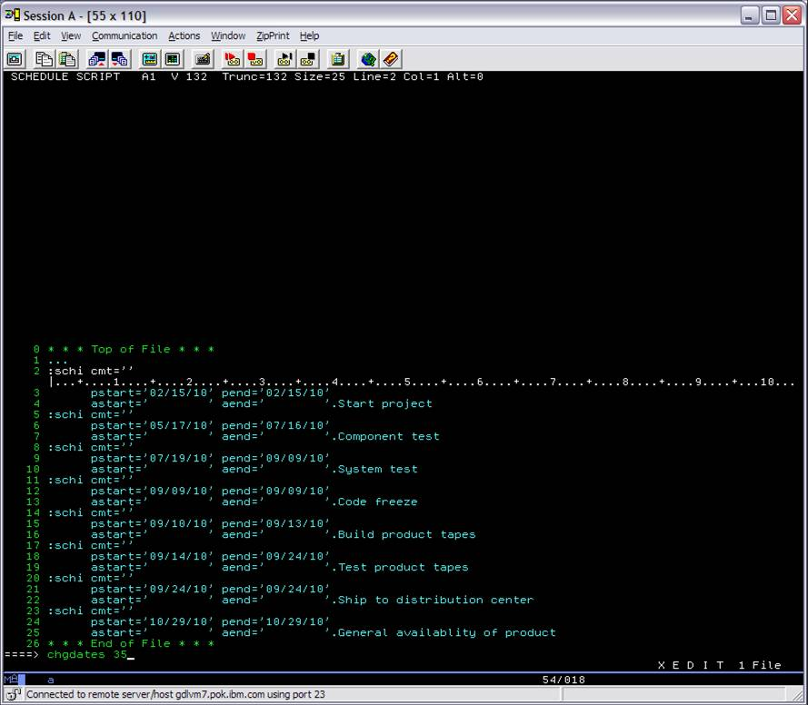

Slide 54
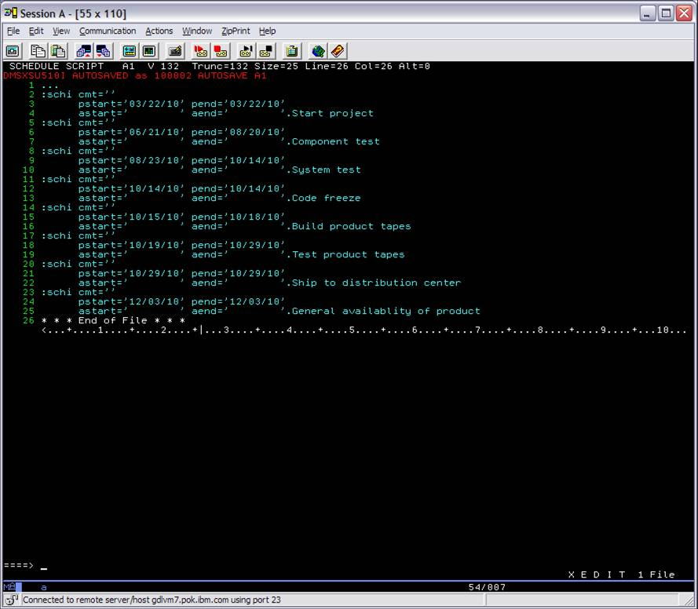

Slide 55
Assignment 2
Write an XEDIT macro to edit C files changing the ‘#include’ lines for H files found in the first column in a conversion file, called CONVERT TABLE, to use the H files from the second column. The C files and CONVERT TABLE file are found on VMSYSU:BAK.ASSIGNMENT2
Hint: Use a PIPE to read CONVERT TABLE into a variable or stem
Send macro with your name in it to userid, MERWYN
Compare your modified C files with those on VMSYSU:BAK.ASSIGNMENT2.RESULTS
I will run your macro on a different set of C files

Slide 56
Assignment 2
Helpful hints
The first line in a REXX exec must be a comment (begins with '/*' and ends with '*/'
This is a pipe command that will read in a file, take the first word in each line and put it into a stem variable (like a list): 'pipe < file text a | spec w1 1 | stem a.'
This is a loop in REXX that will loop through all the variables in a stem: do i=1 to a.0 end

Slide 57
Update Mode
XEDIT with the Update option allows you to:
Modify source program without affecting original source
Record and time-stamp changes in separate update files
Apply and remove changes as needed
Multiple people can update the same source, even at same time
All of VM system source files are processed this way
Requirements of source file
Must have a fixed record format
Must have serialization or sequence numbers on far right side of source
8 digit number in last 8 columns
To add sequence numbers do the following, then FILE
Set TRUNC to 8 less than width of file
SERIAL ALL 10000 10000
Needs gaps in the sequence numbers to add future lines
Lines are referenced in the source by the sequence numbers and not by the line numbers
Make sure SET SERial OFF is in PROFILE XEDIT so sequence numbers in source files are not modified by XEDIT

Slide 58
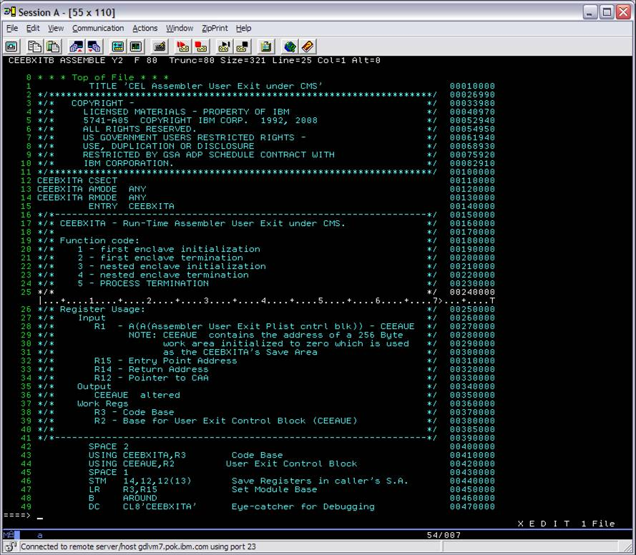

Slide 59
Update Mode
Creating or applying single default update
XEDIT Fn Ft Fm (Update
Changes to source file (Fn Ft Fm) are put into the file Fn UPDATE
Update Control Statements in the updates
All control statements start with ‘./’
Lets you insert, delete, or replace source records, and are automatically generated by XEDIT

Slide 60
Update Mode
Insert control statement
./ I seqno $ seqstart seqincr
Delete control statement
./ D seqno1 seqno2
Replace control statement
./ R seqno1 seqno2 $ seqstart seqincr
Resequencing or comment control statements in the updates must be manually added
Sequence control statement (resequence)
./ S seqstart seqincr
Comment statement
./ * comment

Slide 61
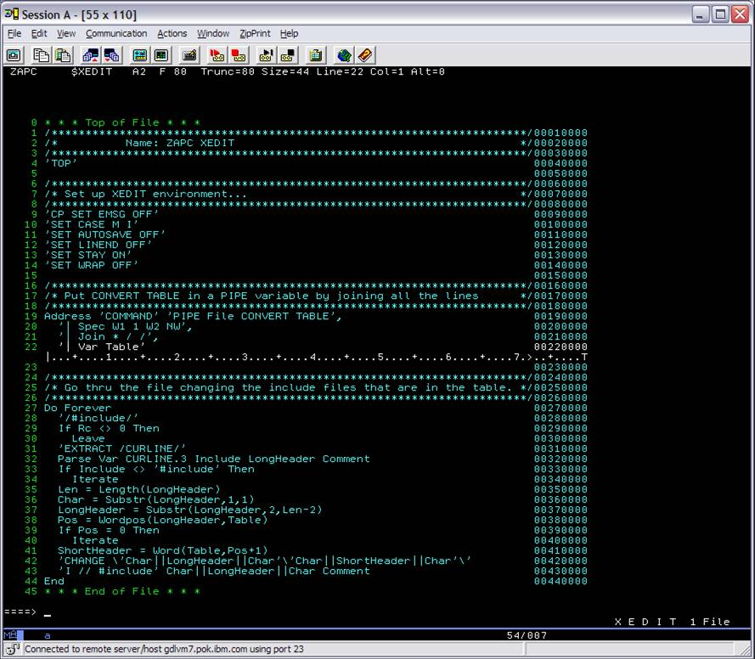

Slide 62
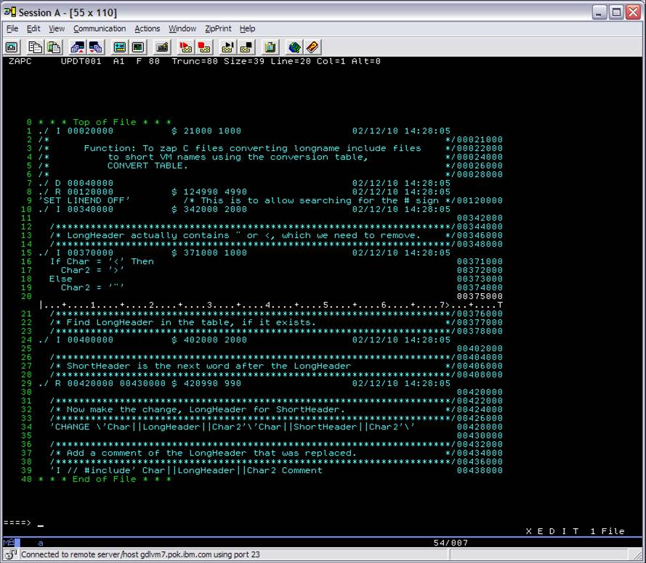

Slide 63
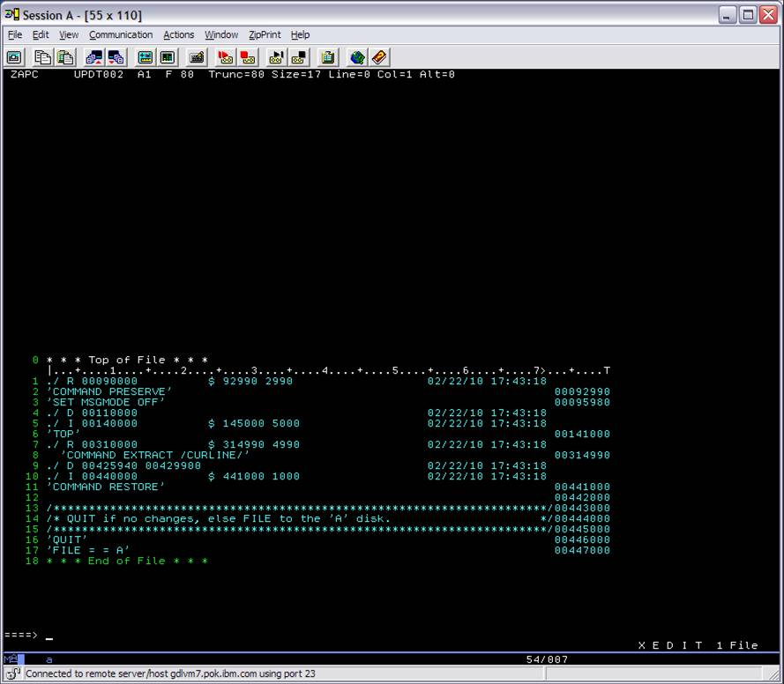

Slide 64
Update Mode
For applying multiple updates:
Auxiliary control files or auxfile or AUX
Lists filetypes of the update files to be applied to the source file, in the order from the bottom to the top
The source file, the auxfile, and the updates must all have the same filename to be applied
A comment in an auxfile starts with an ‘*’
Everything after the first word, which is the update filetype, is a comment

Slide 65
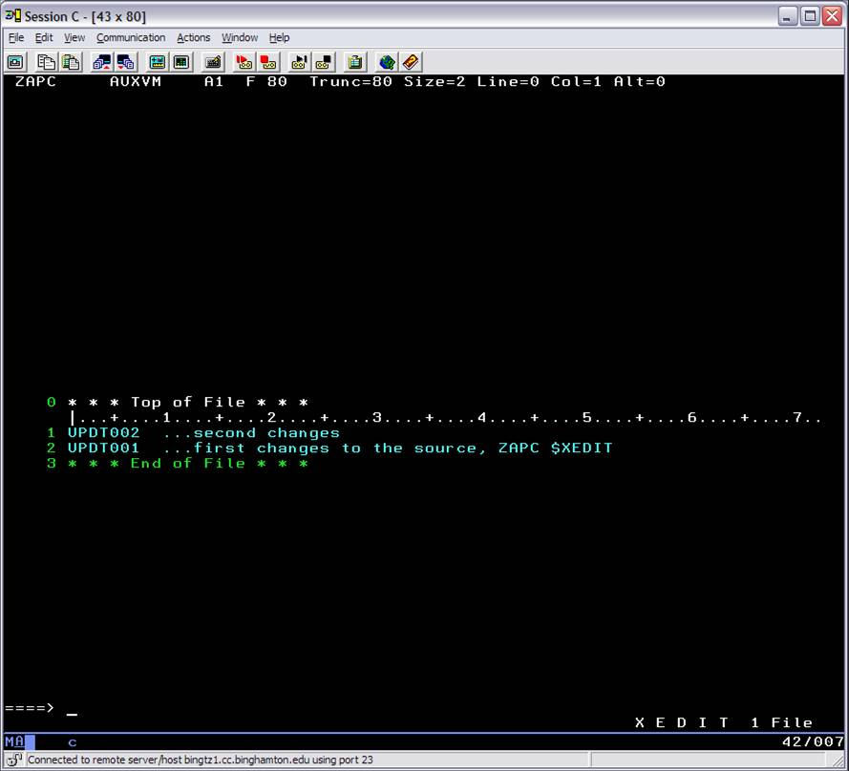

Slide 66
Update Mode
Control files or CNTRL files
A list that indicates the order updates or auxfiles (more lists of updates) are to be applied
Has a filetype of CNTRL
A comment starts with an *
First word in a record is the update level identifier (1-5 char) used to identify objects or text decks
Lists MACLIBs for compiling after a MACS keyword
Lists auxfiles to be applied, in the order from the bottom to the top

Slide 67
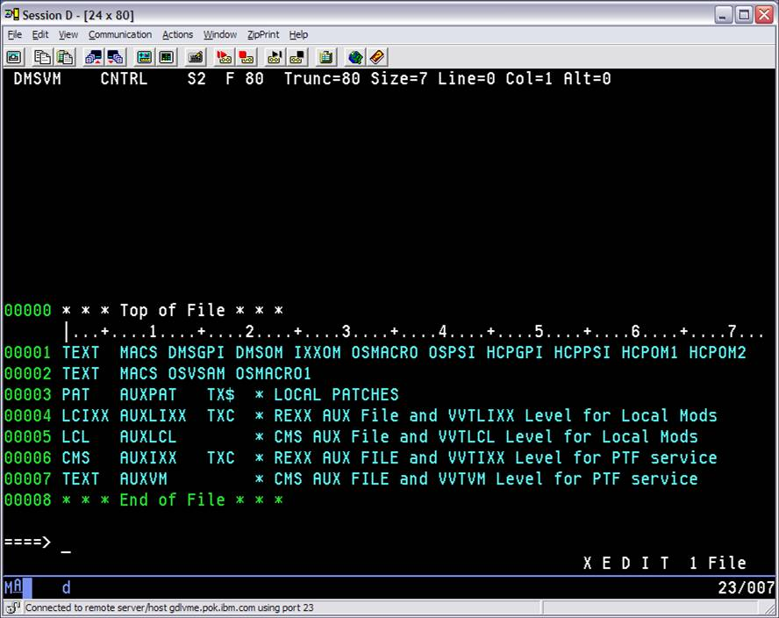

Slide 68
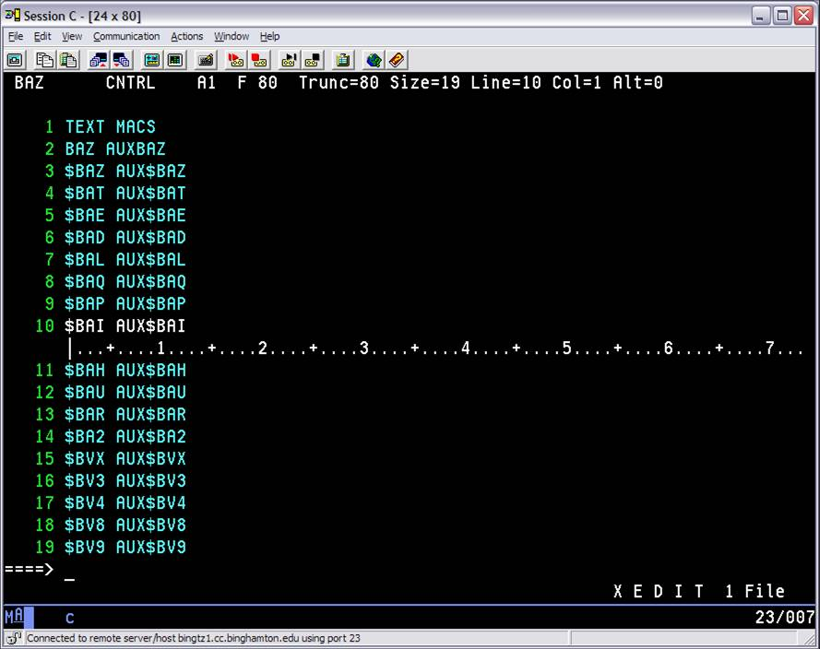

Slide 69
Update Mode
Using a control file and auxfile to apply many updates
XEDIT REPORT ASSEMBLE A (CTL REPORT
Uses REPORT CNTRL as the control file
XEDIT starts with REPORT ASSEMBLE source file
XEDIT searches for updates to apply listed in REPORT CNTRL and the auxfiles listed in REPORT CNTRL
Then the updates are applied to REPORT ASSEMBLE, resulting in an XEDIT session with all the updates applied

Slide 70
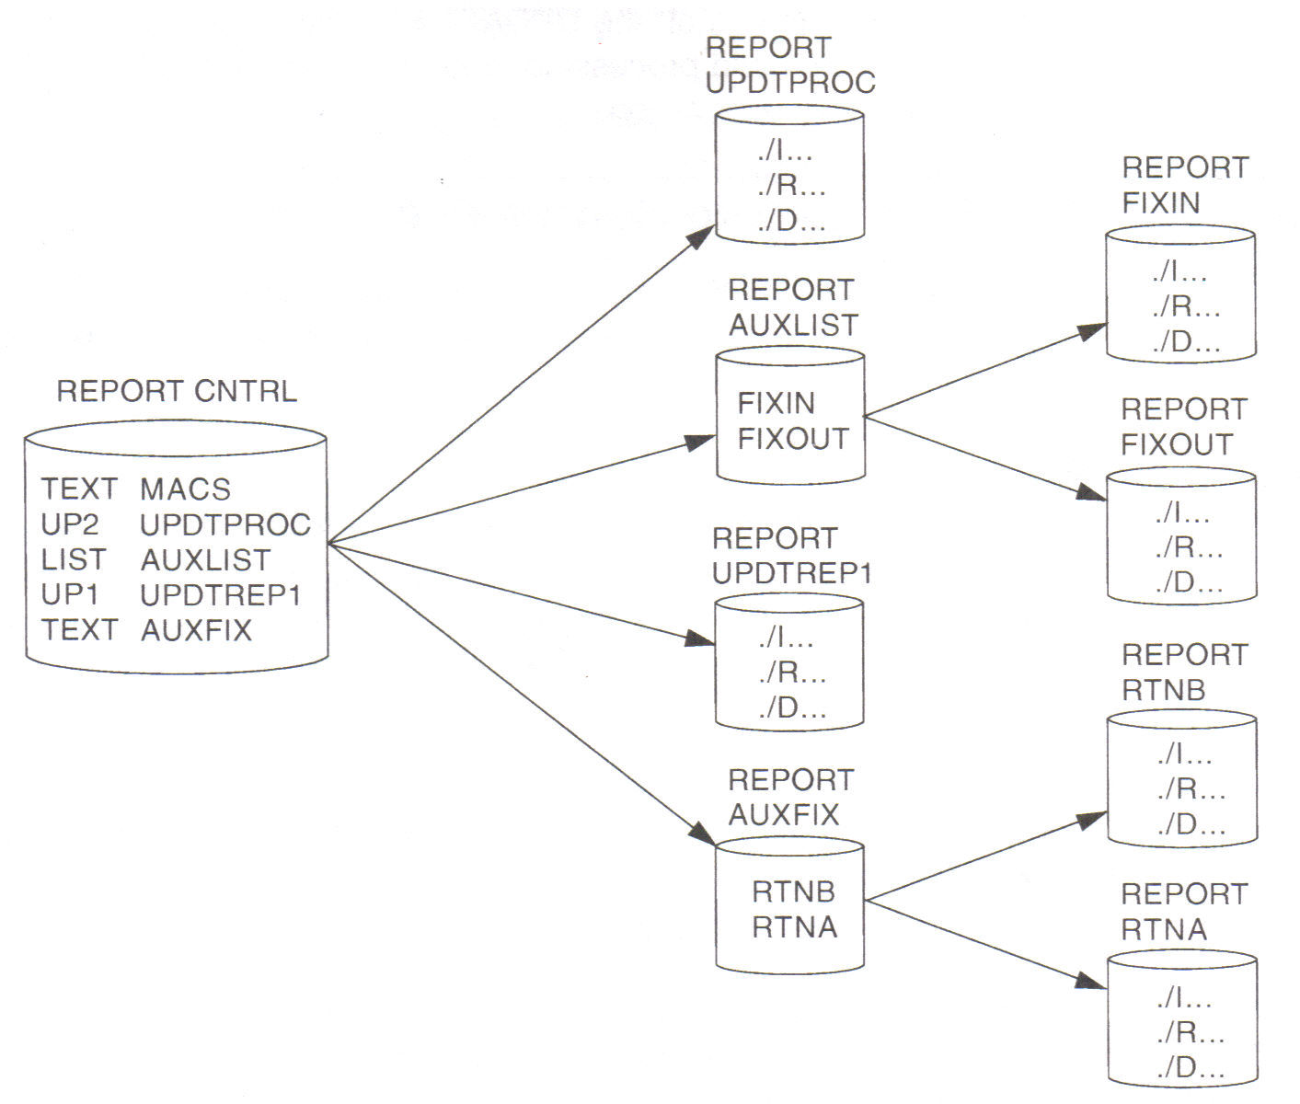
XEDIT REPORT ASSEMBLE A (CTL REPORT
Applying REPORT RTNA A1
Applying REPORT RTNB A1
Applying REPORT UPDTREP1 A1
Applying REPORT FIXOUT A1
Applying REPORT FIXIN A1
Applying REPORT UPDTRPOC A1

Slide 71
Update Mode
Using the UNTIL option
XEDIT ZAPC $XEDIT A (CTL DMSVM UNTIL UPDT001
This applies updates through update UPDT001
XEDIT searches the control file, DMSVM CNTRL, and it’s auxfiles and applies updates until it finds UPDT001
Once in an XEDIT session in update mode, all additional changes go in the last update applied
If want additional changes in a new update (say UPDT003), then first add new update to top of auxfile, ZAPC AUXVM
Ignore the following message, which just states that the update has not been created yet
DMSXUP180W Missing PTF file ZAPC UPDT003 A
PTF stands for Program Temporary Fix

Slide 72
Update Mode
Using CMS EXECUPDT command to apply updates to generate the executable form (XEDIT filetype)
EXECUPDT ZAPC XEDIT * (CTL DMSVM
This actually uses ZAPC $XEDIT as the source
Applies the updates from ZAPC AUXVM, because AUXVM is listed in DMSVM CNTRL
Then it strips off the sequence numbers in col 73-80
Then it creates variable format ZAPC XEDIT A
Also creates ZAPC UPDATES …list of updates applied
Also creates ZAPC UPDLOG …list of changes

Slide 73
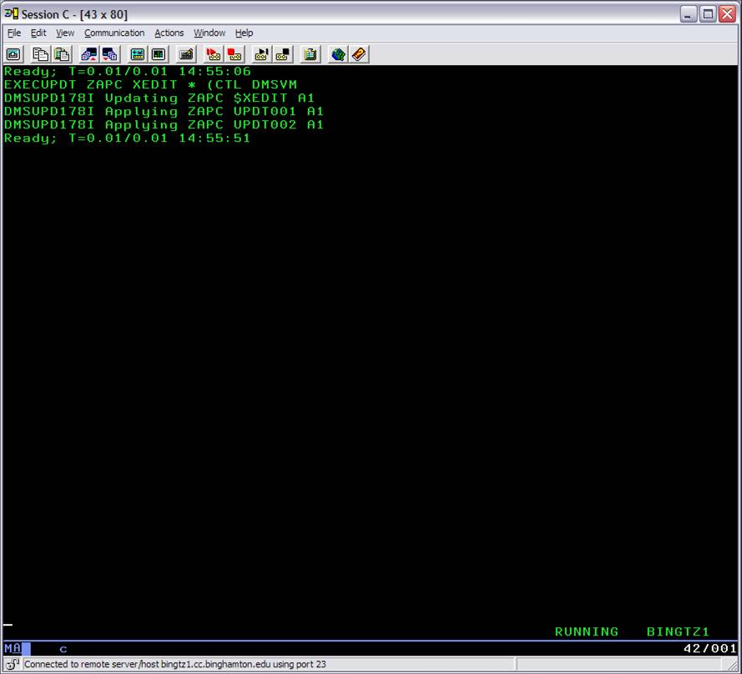

Slide 74
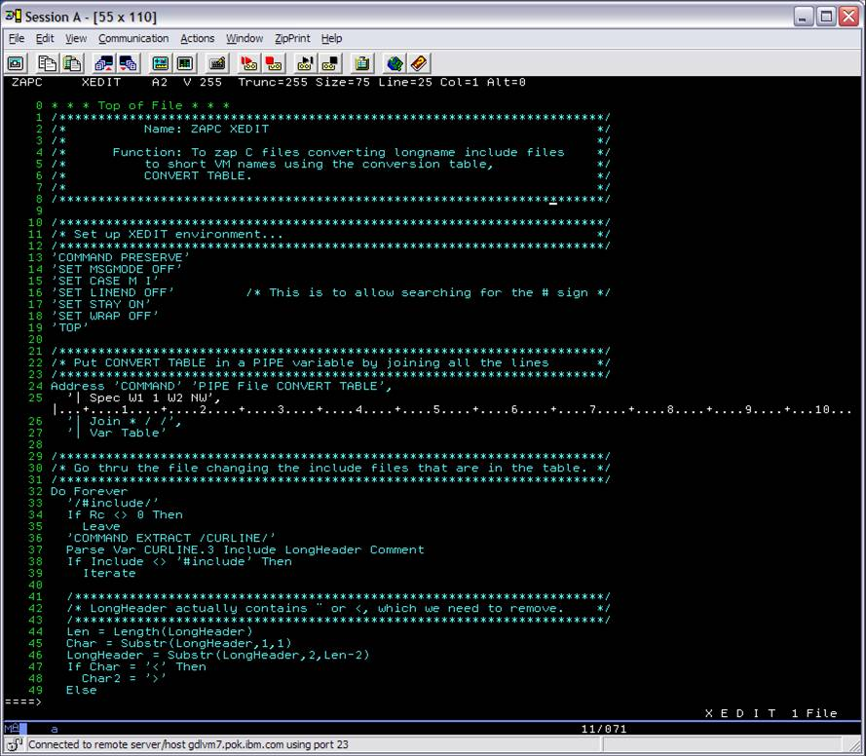

Slide 75
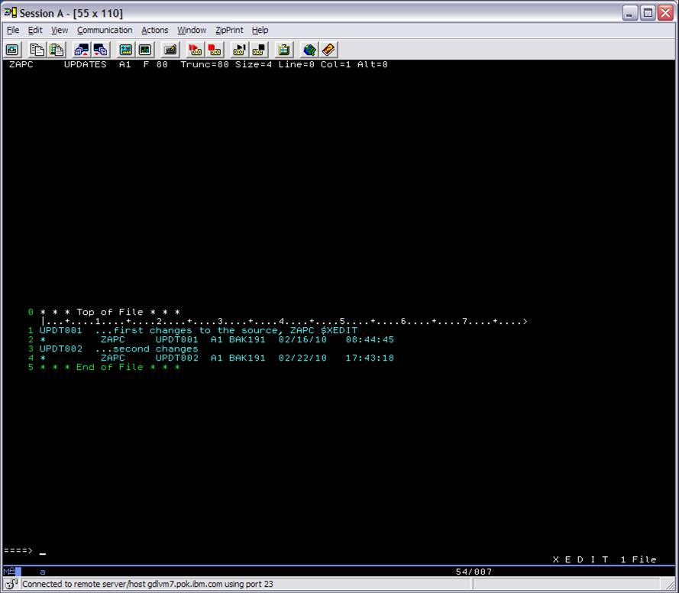

Slide 76
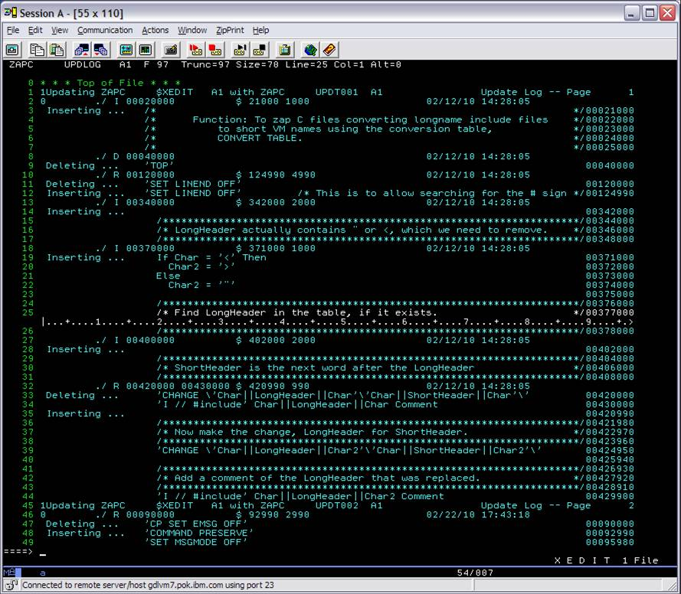

Slide 77
Update Mode
Using CMS UPDATE command to apply updates to the original source to create a new merged source file with sequence numbers
UPDATE ZAPC $XEDIT * DMSVM CNTRL * (CTL
This uses ZAPC $XEDIT as the source
This uses DMSVM CNTRL S2 as the control file
Applies the updates from ZAPC AUXVM, because AUXVM is listed in DMSVM CNTRL
Then it creates $ZAPC $XEDIT A so it doesn’t overlay the original source
If also add option REP, then ZAPC $XEDIT would be created, replacing the original
Also creates ZAPC UPDATES …list of updates applied
Also creates ZAPC UPDLOG …list of changes

Slide 78
